Slide 1

Predicting Wine Preferences of Customers Using Wine Quality Dataset
DATA ANALYST
HARISH BALAJI

Slide 2

Project Overview
Analyze and predict wine quality based on chemical attributes.
1
Goal: Analyze and predict wine quality based on chemical attributes.
2
Dataset: WineQT.csv with 12 columns (alcohol, acidity, sulphates, etc.) and quality
This project bridges data Analysis with real-world product quality evaluation, helping businesses turn raw data into meaningful and actionable decisions.
3

Slide 3

01
02
EXCEL
SQL
.
.
TOOLS
USED
03
04
PYTHON
POWER BI
.

Slide 4

01
EXCEL
for initial data cleaning and manual inspection.

Slide 5

Initial Data Handling & Cleaning
Cleaning Uncleaned Data into Cleaned Data
Uncleaned Data
Cleaned Data

Slide 6

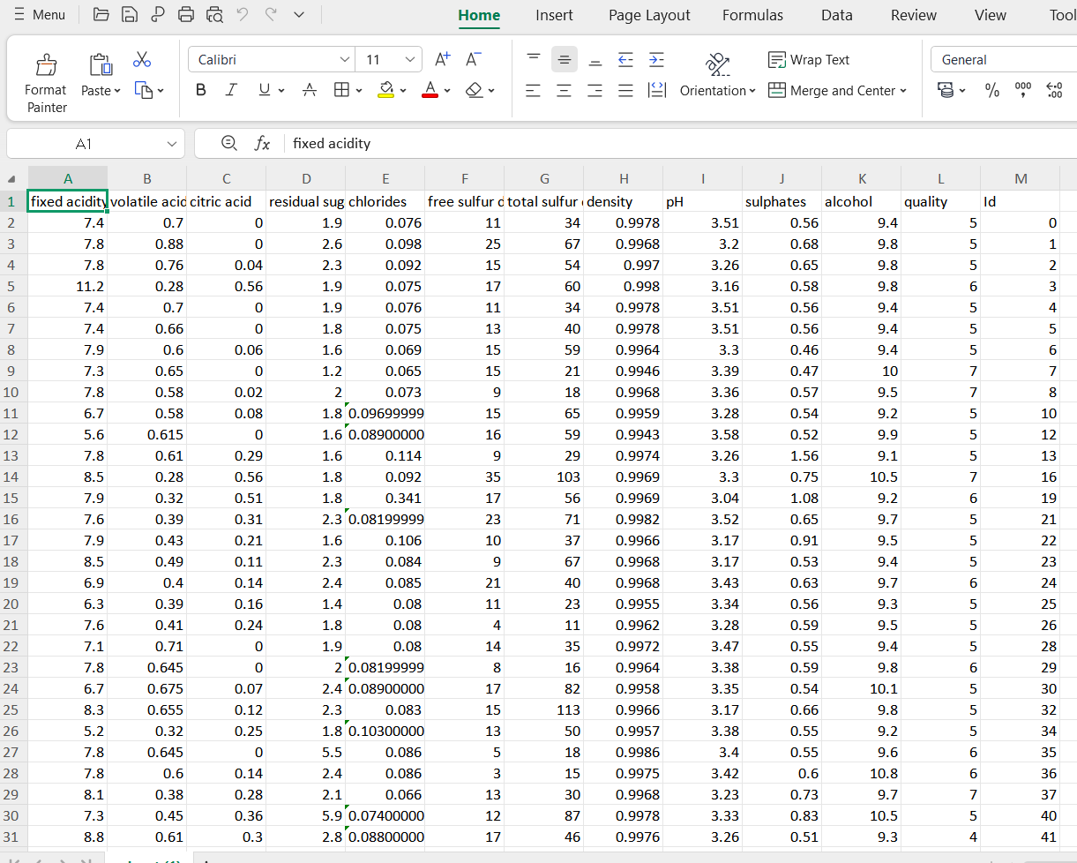




Data Cleaning in Excel for Wine Quality Prediction
Data types were verified and corrected
Used to Remove Duplicates
Using Filters and conditional formeting

Slide 7
Data Cleaning in Excel for Wine Quality Prediction
Remove Duplicates
Handle Missing Values
Used Excel’s “Remove Duplicates” feature to eliminate repeated records and ensure data integrity.
dentified blank cells using filters and filled or removed rows using logical functions like IF and ISBLANK.
1
4
2
Detect & Treat Outliers
3
Standardize Column Data
Used conditional formatting and basic statistical formulas (like mean & standard deviation) to highlight and review anomalies.
Applied TRIM, LOWER, and PROPER functions to fix inconsistent text formatting and align data.

Slide 8
02
SQL
Enabled structured storage and SQL analysis.

Slide 9
Using SQL in Wine Quality Data Analysis
Data Extraction from SQL
Data Aggregation & Insights
SQL was used to extract relevant records from the wine dataset using SELECT, WHERE, and ORDER BY clauses to filter and sort data effectively.
With GROUP BY, AVG(), and COUNT(), SQL queries helped summarize quality ratings and analyze relationships between variables like alcohol content and acidity.
.

Slide 10




SQL Process Flow for Project Analysis
Data import
Table Creation
Query Execution
Result Export
Loaded cleaned dataset into MySQL from Excel for structured storage..
Created normalized tables to organize fields by categories
Ran SQL queries to filters and summarize
Exported query results for visualization
01
02
03
04

Slide 11
SQL Project Workflow
Import Data
Create Tables
01
Loaded the cleaned dataset into MySQL for structured storage.
02
Designed normalized tables to organize data efficiently
Run Queries
Export Results
03
Used SQL SELECT, JOIN, and GROUP BY to extract insights.
04
Exported query outputs for further visualization and reporting.

Slide 12

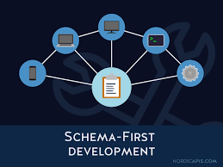



SQL Project Flow
Data Cleaning
Query Implementation
Removed duplicates, handled nulls,
Used SQL queries to extract and filter
2
4
1
3
5
Data Collection
Schema Design
Insight Extraction
Gathered raw data from various sources (CSV, API, etc.).
Created efficient SQL table structures for better data management
Analyzed results to derive patterns and support decision-making.

Slide 13


SQL Integration in the Project
Database Setup
Imported the cleaned wine dataset into MySQL using phpMyAdmin (XAMPP).
Created a structured table (wine_data) to store features like alcohol, acidity, and quality.
Querying for Insights
Executed SQL queries to calculate averages, totals, and grouped statistics.
“Real-time data analysis using MySQL queries to explore and summarize wine quality insights.”
Connected to Power BI
Used the SQL database as a live data source for Power BI.
Enabled automatic refresh and dynamic visualization updates using SQL views.

Slide 14
03
PYTHON
Python was used for cleaning, analyzing, and visualizing the wine dataset to identify key factors affecting quality.

Slide 15
Python Libraries Used in the Project
01
02
03
04
Pandas
NumPy
Matplotlib
Seaborn
Used for importing, cleaning, and transforming the dataset.
Helped with numerical operations and statistical calculations.
Used to create basic visualizations like histograms and bar plots.
Used for advanced, aesthetic charts like boxplots and heatmaps.

Slide 16
Python Workflow – Wine Quality Prediction
No. | Introduction | Problem/Action | Conclusion
1 | Imported dataset | Loaded CSV using Pandas | Data successfully read
2 | Inspected structure | Checked nulls, dtypes, and duplicate rows | Identified issues
3 | Cleaned data | Removed missing values and duplicates | Clean dataset ready
4 | Feature engineering | Created Alcohol_Level, Quality_Category | Enhanced dataset
5 | Handled outliers | Used boxplots and IQR filtering | Removed extreme noise
6 | Visualization setup | Set up Seaborn and Matplotlib for graphs | Ready for EDA
7 | Performed EDA | Plotted histograms, boxplots, heatmaps | Found top quality drivers
8 | Correlation analysis | Analyzed alcohol, acidity, sulphates vs quality | Key feature insights found
9 | Final review | Dataset saved as wine_cleaned.csv | Ready for SQL/Power BI

Slide 17
04
POWER BI
Created an interactive dashboard to visualize wine quality insights.

Slide 18

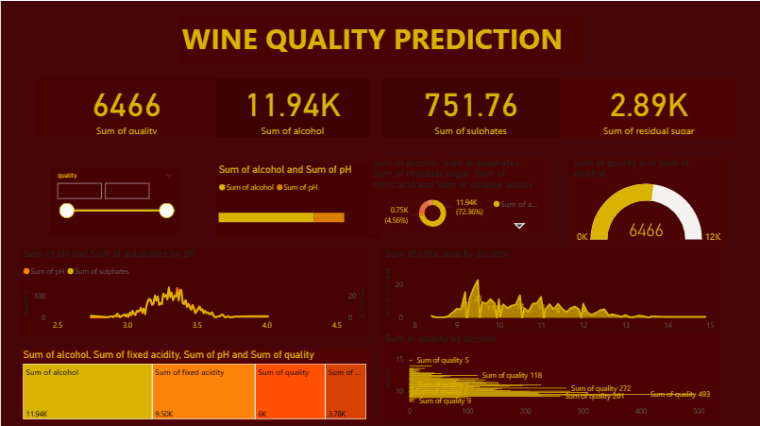
Power BI in the Project
Power BI Dashboard
An interactive dashboard was built to visually analyze the impact of alcohol, acidity, and sulphates on wine quality.
The visuals made it easy to understand patterns and trends
KPI Cards
Visual
Analysis
Interactive
Filters

Slide 19
Power BI Contribution to the Project
Data Visualization
Key Insights
Created interactive charts to show how features like alcohol and acidity influence wine quality.
Revealed important patterns: high alcohol increases quality, volatile acidity lowers it.
User Interactivity
Easy Reporting
Added slicers for Alcohol Level, pH, and Quality Rating so users can filter data easily.
Summarized results using KPI cards and matrix tables for clean, client-friendly reporting.

Slide 20
Tools Used & Final Output Overview
🛠 Tools Used:
Excel: For initial data cleaning, handling missing values, and creating new columns like Alcohol_Level.
Python (Pandas, NumPy, Matplotlib, Seaborn): Used for preprocessing, feature engineering, exploratory data analysis, and visualization.
SQL (XAMPP with MySQL):Structured storage and querying of the cleaned dataset; enabled efficient data retrieval.
Power BI:Designed an interactive and dynamic dashboard for final visualization and insights.

Slide 21
Final Dashboard

Slide 22
THANKS
Thank you for your time and attention
HARISH BALAJI

